Slide 1

GAME ANALYSIS with SQL
MENTORNESS
Internship Project by
Raj Jadhav
Batch : MIP-DA-06

Slide 2
Content
Project Overview
Dataset Description
Entity Relationship Diagram
Analysis (Queries)
Summery

Slide 3

Project Overview
Decode Gaming Behavior” involves analyzing a gaming application’s dataset with ”Player Details” and “Level Details” tables. Its objective is to extract insights into player behavior and performance. Utilizing SQL queries. We aim to understand player engagement, skill progession, and areas for game experience enhancement.
Key questions include player trend, level completion rates, and performance metrics analysis. Our goal is to provide actionable insights for informed decision making in game development.
The project encompasses data exploration, query formulation, result interpretation and data visualization techniques. Through concise presentation.
We facilitate stakeholders’ understanding and decision making in game development and management.

Slide 4
DATASET DESCRIPTION
The dataset includes two table : ’Player Details’ and ‘Level Details’
PLAYER DETAILS TABLE:
Level Details Table :
‘P_ID’ : PLAYER ID
‘PName’: Player Name
‘L1_status’ : Level 1 Status
‘L2_status’ : Level 2 Status
‘L1_code’ : System generated Level 1 code
‘L2_code’ : System generated Level 2 code
‘P_ID’ : Player ID
‘Dev_ID’ : Device ID
‘start_time’ : Start Time
‘stages_crossed’ : Stages Crossed
‘level’ : Game Level
‘difficulty’ : Difficulty Level
‘kill_count’ : Kill Count
‘headshots_count’ : Headshots Count
‘score’ : Player Score
‘lives_earned’ : Extra Lives Earned

Slide 5
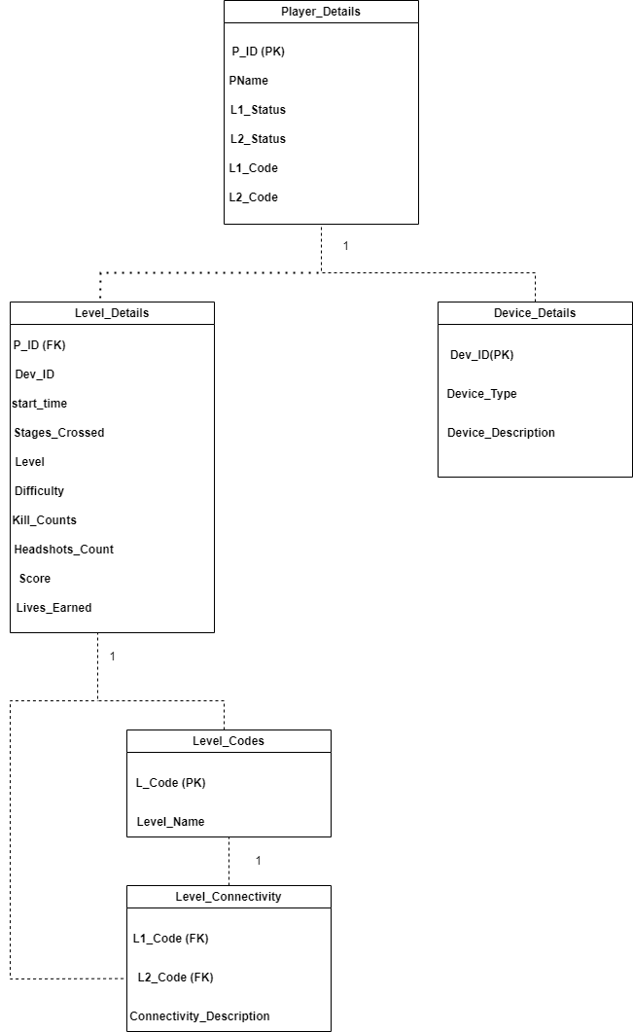
Entity Relationship Diagram
Entity Relationship Diagram
We’ve added a new entity called “Device_Details” to capture information about the devices used by players
The “Level_Details” table now included an attribute Dev_ID to indicate which device was used
Another entity called “Level_Codes” is introduced to store information about the codes associated with each level.
“Level_Connectivity” represents the relationships between levels, using the codes from “Level_Codes” to indicate the connectivity between different levels.
Arrows indicate the relationships between entities, with cardinality specified where necessary (1-to-many relationships).

Slide 6
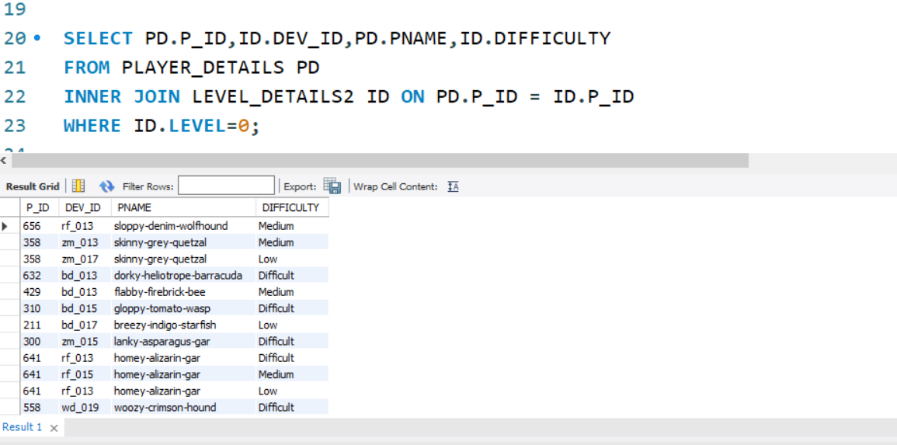
Analysis (Queries)
Query – 1
Extract P_ID,Dev_ID,Pname and Difficulty_level of all players at level 0.
SELECT PD.P_ID,ID.DEV_ID,PD.PNAME,ID.DIFFICULTYFROM PLAYER_DETAILS PDINNER JOIN LEVEL_DETAILS2 ID ON PD.P_ID = ID.P_IDWHERE ID.LEVEL=0;
Analysis – it performs an inner join onn the Player ID column between the two tables to retrieve matching records based on the Player ID.

Slide 7
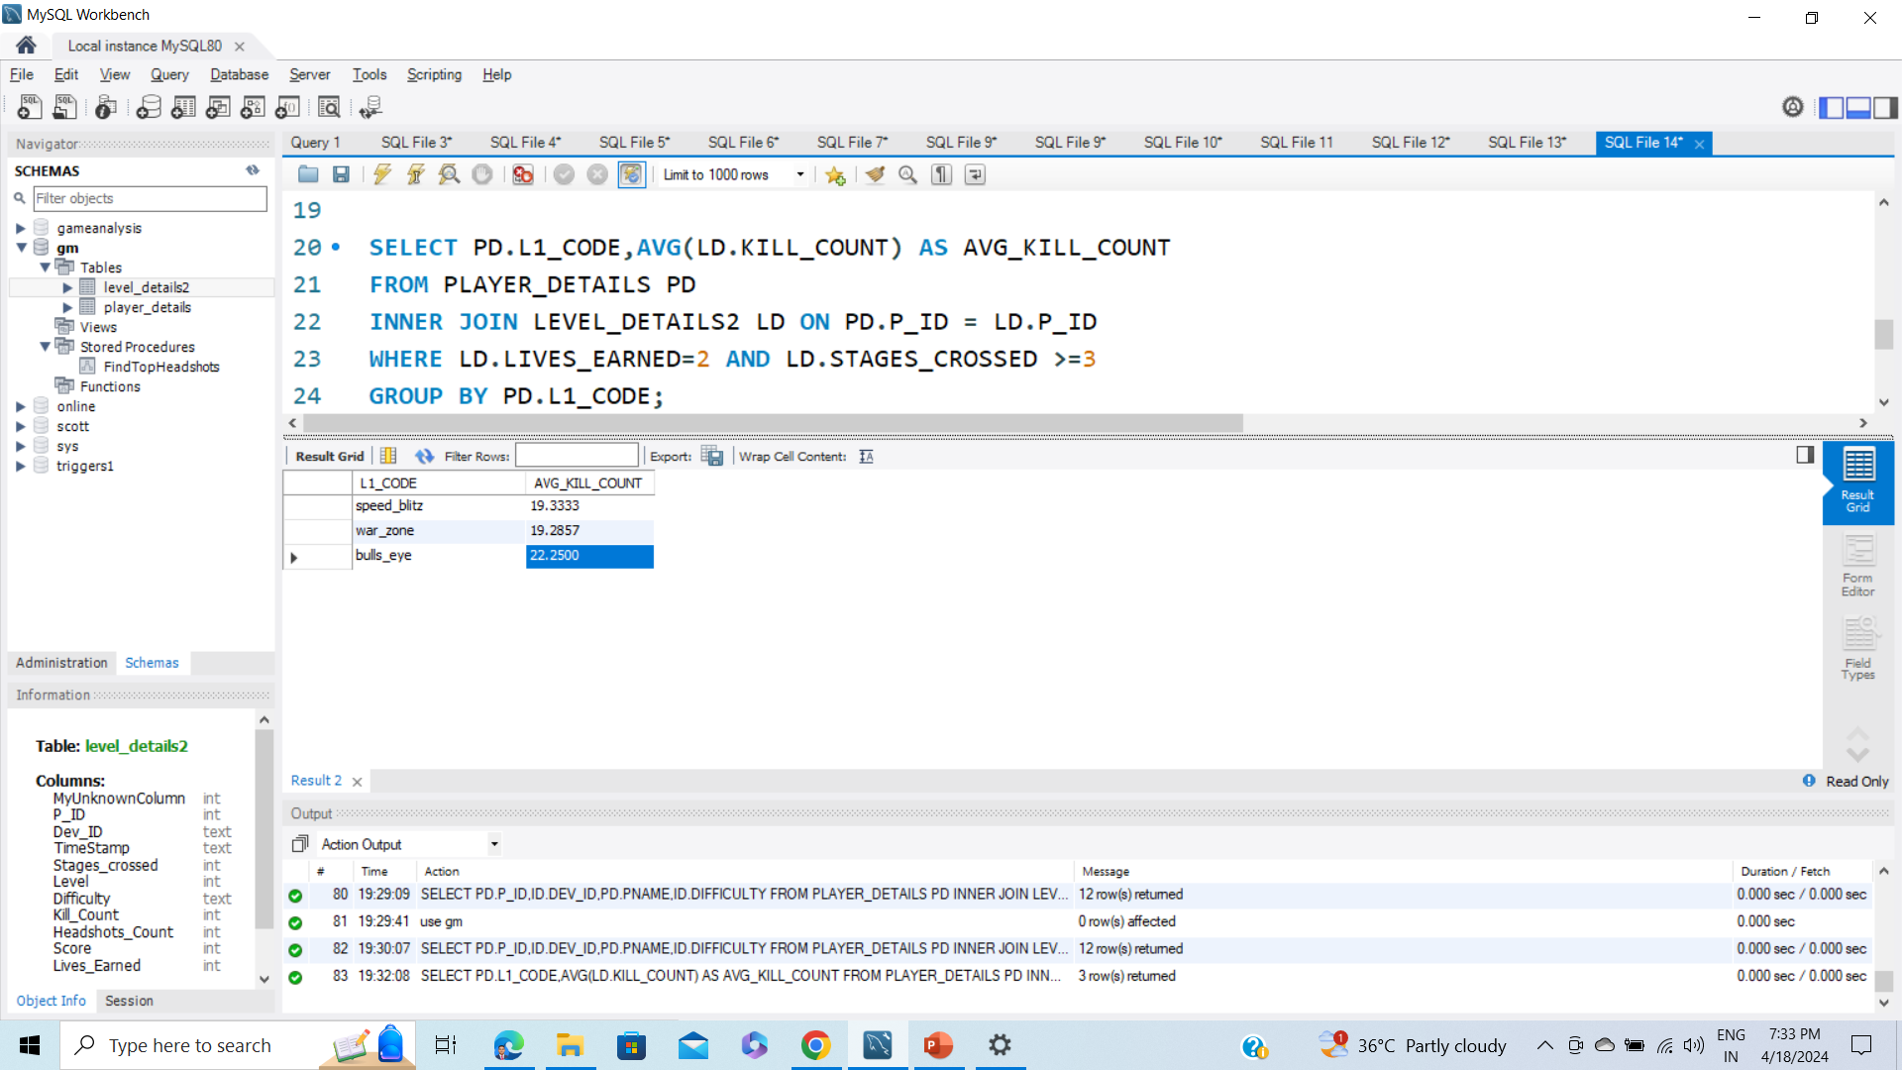
Query – 2
Final Level1_code wise Avg_Kill_Count where lives_earned is 2 and at least 3 stages are crossed
SELECT PD.L1_CODE,AVG(LD.KILL_COUNT) AS AVG_KILL_COUNTFROM PLAYER_DETAILS PDINNER JOIN LEVEL_DETAILS2 LD ON PD.P_ID = LD.P_IDWHERE LD.LIVES_EARNED=2 AND LD.STAGES_CROSSED >=3GROUP BY PD.L1_CODE;
Analysis – it performs an inner join onn the Player ID column between Player_Details and Level_Details tables to retrieve matching records based on the Player ID.
The result is grouped by L1_code.

Slide 8
Query – 3
Find the total number of stages crossed at each difficulty level where for Level2 with players use zm_series device. Arrange the result.
SELECT ld.difficulty, SUM(ld.stages_crossed) AS total_stages_crossed FROM Level_Details ld
INNER JOIN Player_Details pd ON ld.P_ID = pd.P_ID WHERE ld.level = 2 AND ld.Dev_ID LIKE 'zm_series%’ GROUP BY ld.difficulty
ORDER BY total_stages_crossed DESC
Analysis – it performs an inner join on with Player_Details table based on the Player Id. The result is grouped by difficulty and ordered by the total number of stages crossed in descending order.

Slide 9
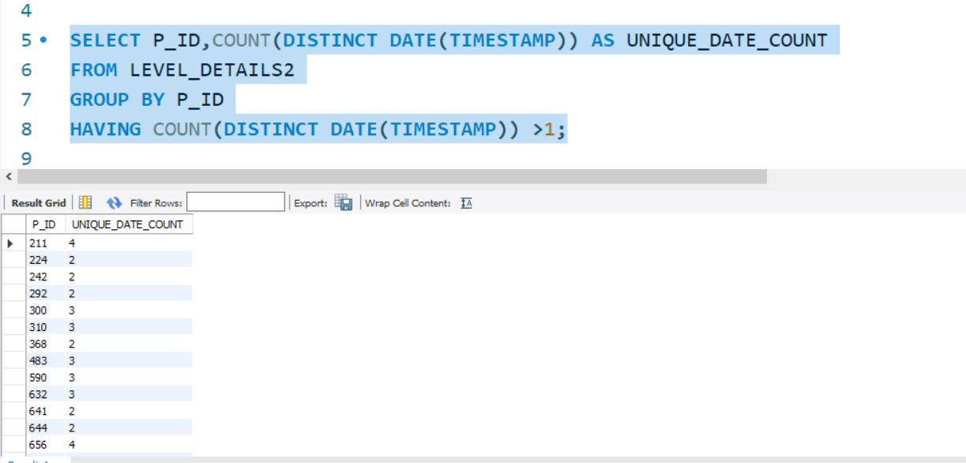
Query –4
Extract P_ID and the total number of unique dates for those players who have played games on multiple days.
SELECT P_ID,COUNT(DISTINCT DATE(TIMESTAMP)) AS UNIQUE_DATE_COUNTFROM LEVEL_DETAILS2GROUP BY P_IDHAVING COUNT(DISTINCT DATE(TIMESTAMP)) >1;
Analysis – It groups the results by p_ID and filter out the groups where the count of unique dates is greater than 1. This query helps identify players who have started games on multiple dates

Slide 10
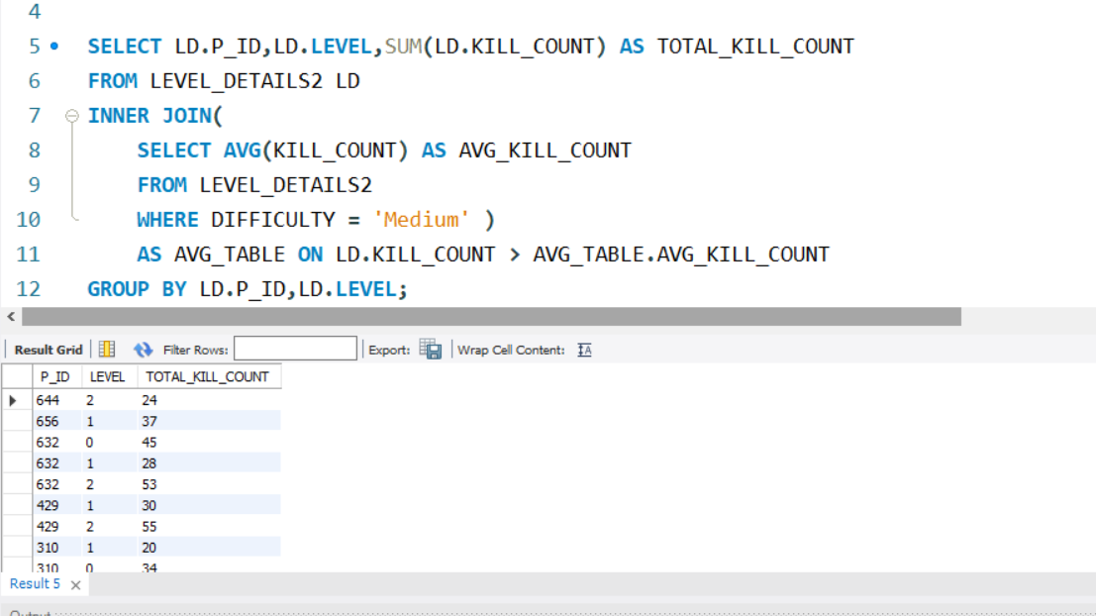
Query – 5
Find P_ID and level wise sum of kill_counts where kill_count is greater than avg kill count for the Medium difficulty
SELECT LD.P_ID,LD.LEVEL,SUM(LD.KILL_COUNT) AS TOTAL_KILL_COUNTFROM LEVEL_DETAILS2 LDINNER JOIN( SELECT AVG(KILL_COUNT) AS AVG_KILL_COUNT FROM LEVEL_DETAILS2 WHERE DIFFICULTY = 'Medium' ) AS AVG_TABLE ON LD.KILL_COUNT > AVG_TABLE.AVG_KILL_COUNTGROUP BY LD.P_ID,LD.LEVEL;
Analysis – It filters the data based on the conditions that the Kill_Count is greater than the average Kill_Count for records with the Difficulty_level set to ‘Medium’. Finally,it groups the result by P_ID and Level. This query helps identify players who have achieved above-average kill counts in levels classified as ‘Medium difficulty’.

Slide 11
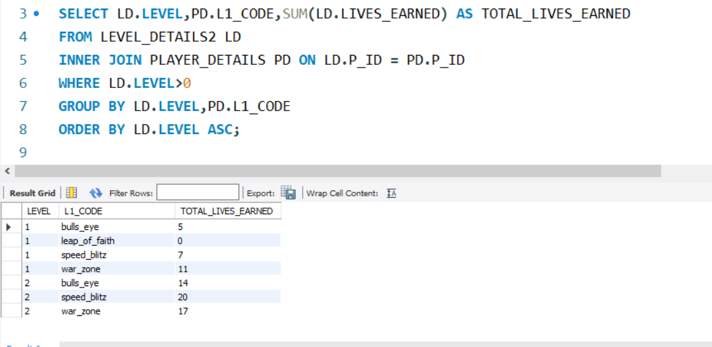
Query – 6
Find Level and its corresponding Level code wise sum of lives earned excluding level 0. Arrange in ascending order of level.
SELECT LD.LEVEL,PD.L1_CODE,SUM(LD.LIVES_EARNED) AS TOTAL_LIVES_EARNEDFROM LEVEL_DETAILS2 LDINNER JOIN PLAYER_DETAILS PD ON LD.P_ID = PD.P_IDWHERE LD.LEVEL>0GROUP BY LD.LEVEL,PD.L1_CODEORDER BY LD.LEVEL ASC;
Analysis – It filters the data to exclude Level 0. which typically represents the initial level or setup phase. Then, it calculates the sum of lives earned for each level and groups the results by Level and Level_code. Finally, it orders the results by Level in ascending order.

Slide 12
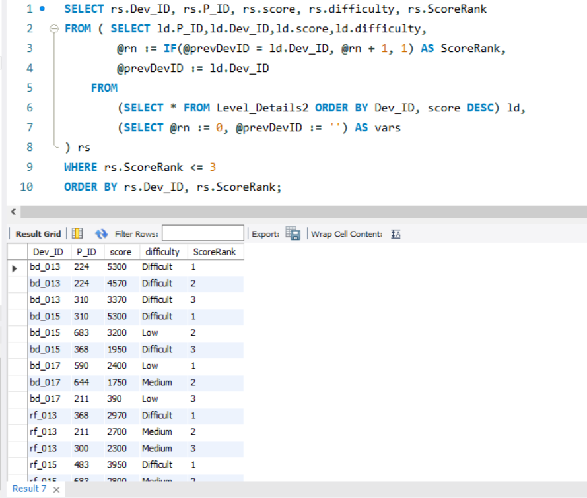
Query – 7
Find Top 3 score based on each dev_id and Rank them in increasing order using Row_Number. Display difficulty as well.
SELECT rs.Dev_ID, rs.P_ID, rs.score, rs.difficulty, rs.ScoreRankFROM ( SELECT ld.P_ID,ld.Dev_ID,ld.score,ld.difficulty, @rn := IF(@prevDevID = ld.Dev_ID, @rn + 1, 1) AS ScoreRank, @prevDevID := ld.Dev_ID FROM (SELECT * FROM Level_Details2 ORDER BY Dev_ID, score DESC) ld, (SELECT @rn := 0, @prevDevID := '') AS vars) rsWHERE rs.ScoreRank <= 3ORDER BY rs.Dev_ID, rs.ScoreRank;
Analysis – By partitioning the data by Developer_ID and ranking scores within each group, the query efficiently retrieves the highest scores. The main query then selects the Developer_ID. Difficulty Level,Score,and Rank from the TopScores CTE,ensuring only the top three scores are included for each developer.

Slide 13
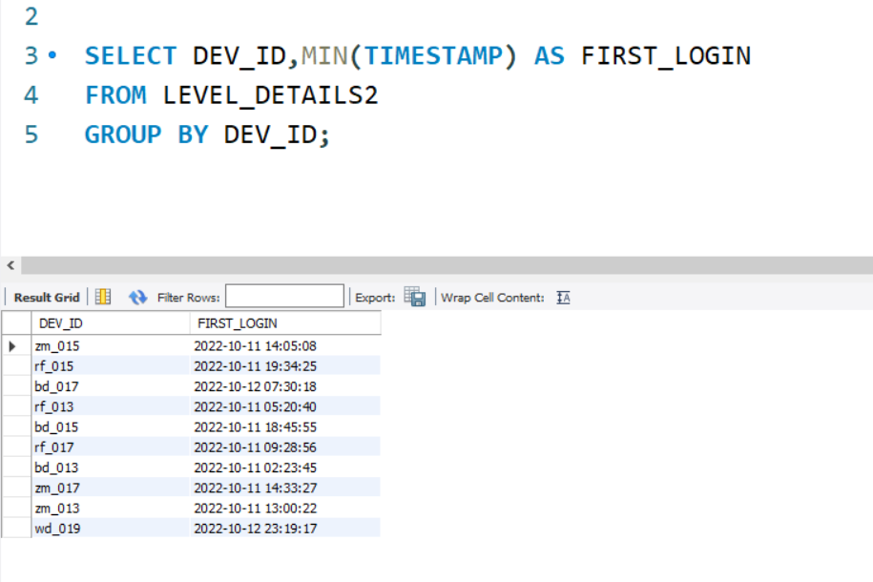
Query – 8
Final first_login datetime for each device id.
SELECT DEV_ID,MIN(TIMESTAMP) AS FIRST_LOGINFROM LEVEL_DETAILS2GROUP BY DEV_ID;
Analysis – The SQL query retrieves the earliest login timestamp for each developer by selecting the minimum start datetime grouped by the developer’s ID from the Player_Details.

Slide 14
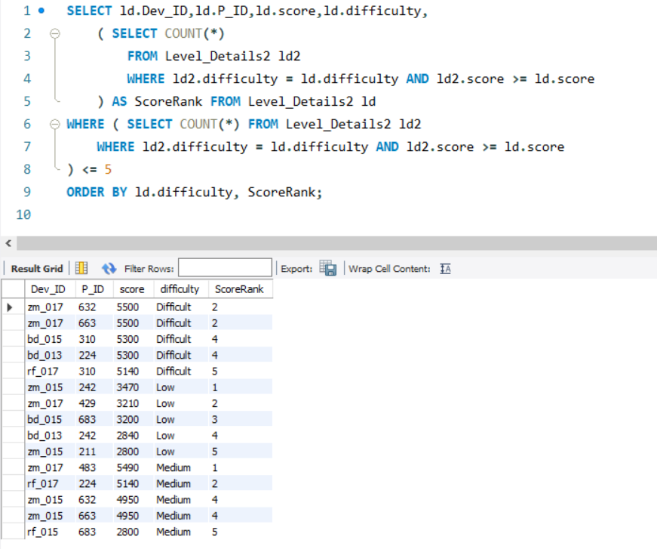
Query – 9
Find Top 5 Score based on each difficulty level and Rank them in increasing order using Rank. Display dev_id as well.
SELECT ld.Dev_ID,ld.P_ID,ld.score,ld.difficulty, ( SELECT COUNT(*) FROM Level_Details2 ld2 WHERE ld2.difficulty = ld.difficulty AND ld2.score >= ld.score ) AS ScoreRank FROM Level_Details2 ldWHERE ( SELECT COUNT(*) FROM Level_Details2 ld2 WHERE ld2.difficulty = ld.difficulty AND ld2.score >= ld.score) <= 5ORDER BY ld.difficulty, ScoreRank;
Analysis – It assigns a rank to each score based on descending order. Then, it selects the developer ID, difficulty level, score and rank from the TopScores CTE where the rank is less than or equal to 5.

Slide 15
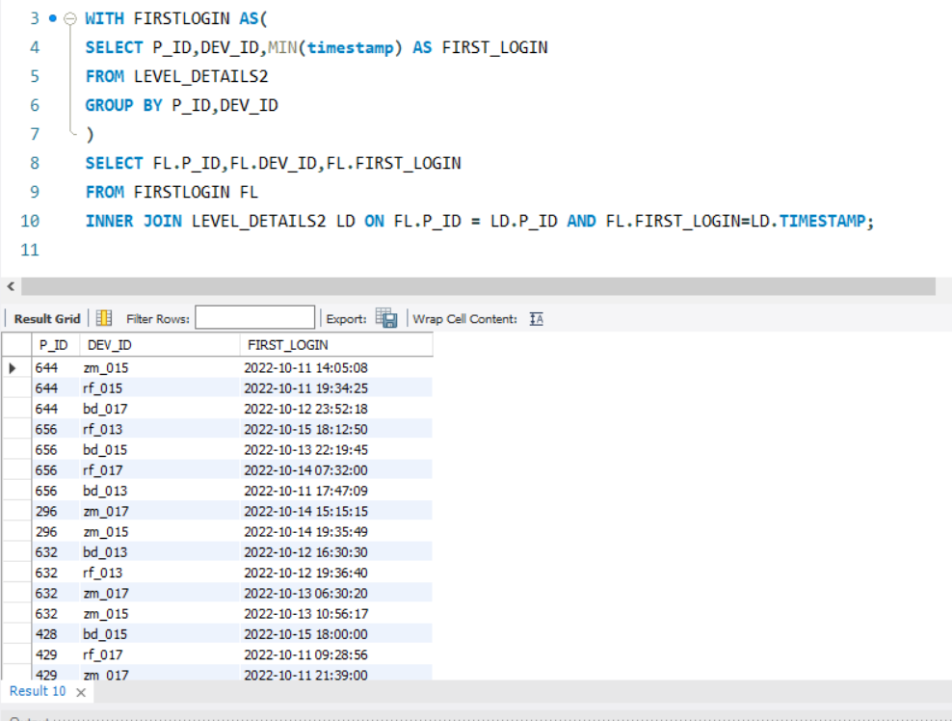
Query – 10
Find the device ID that is first logged in(based on start_datetime) for each player(p_id). Output should contain player id, device id and first login datetime
WITH FIRSTLOGIN AS(SELECT P_ID,DEV_ID,MIN(timestamp) AS FIRST_LOGINFROM LEVEL_DETAILS2GROUP BY P_ID,DEV_ID)SELECT FL.P_ID,FL.DEV_ID,FL.FIRST_LOGINFROM FIRSTLOGIN FLINNER JOIN LEVEL_DETAILS2 LD ON FL.P_ID = LD.P_ID AND FL.FIRST_LOGIN=LD.TIMESTAMP;
Analysis – It assigns a row number to each login record within each player’s data, ordered by the start_datetime. Then, it selects the player ID(P_ID),developer ID(Dev_ID), and the start_datetime corresponding to the first login (identified by RowNum = 1) from the FirstLogin CTE.

Slide 16
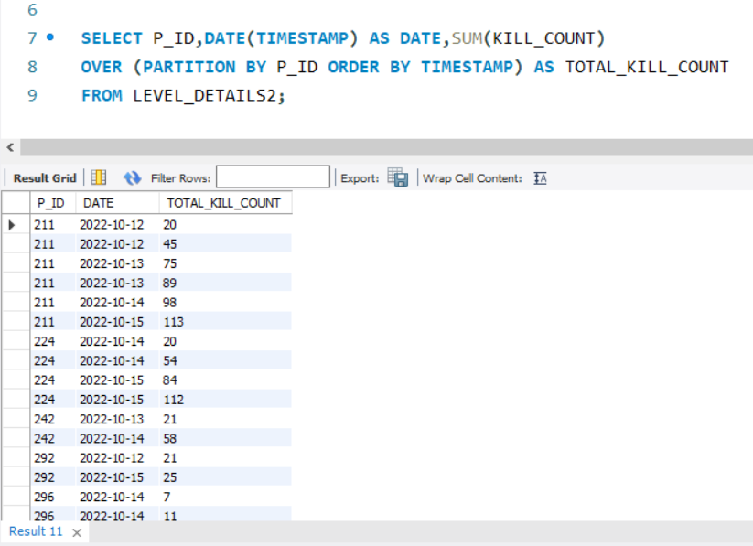
Query – 11
For each player and date, how many kill_count played so far by the player. That is, the total number of games played by the player until that date.
Window function
SELECT P_ID,DATE(TIMESTAMP) AS DATE,SUM(KILL_COUNT)OVER (PARTITION BY P_ID ORDER BY TIMESTAMP) AS TOTAL_KILL_COUNTFROM LEVEL_DETAILS2;
Analysis – It utilizes the window function SUM() with the OVER() clause to partition the data by P_ID and order it by start_datetime. This allows tracing the total kill count accumulated by each player as they progress through the game sessions, adding in analyzing player performance trends and engagement levels over time.

Slide 17

Query – 11
Without Window function
SELECT P_ID,DATE(TIMESTAMP) AS DATE,SUM(KILL_COUNT) AS TOTAL_KILL_COUNTFROM LEVEL_DETAILS2GROUP BY P_ID,DATE(TIMESTAMP);
Analysis – It utilizes a correlated subquery to sum the Kill_count values from the Game_Data table for each player where the start_Datetime is less than or equal to the start_datetime of the current row. This provides a running total of kill counts for each player as they progess through their gaming session

Slide 18
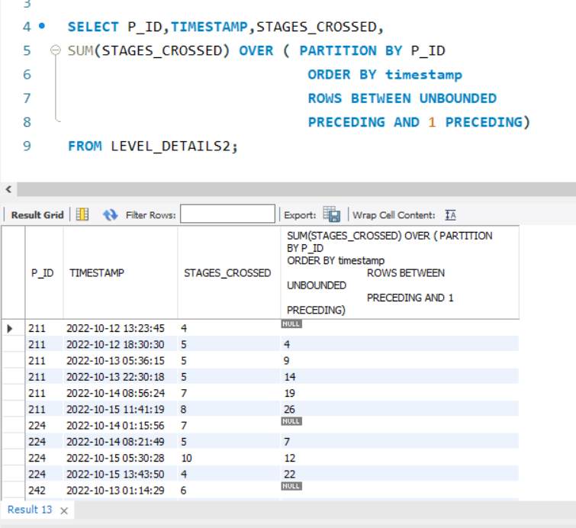
Query – 12
Find the cumulative sum of stages crossed over a start_datetime for each player id but exclude the most recent start_datetime
SELECT P_ID,TIMESTAMP,STAGES_CROSSED,SUM(STAGES_CROSSED) OVER ( PARTITION BY P_I ORDER BY timestamp ROWS BETWEEN UNBOUNDED PRECEDING AND 1 PRECEDING)FROM LEVEL_DETAILS2;
Analysis – It utilizes the SUM() function with the window function OVER() to sum the stages_crossed values from the Game Data Table for each player. THE ROWS BETWEEN UNBOUNDED PRECEDING AND 1 PRECEDING clause specifies the range of rows to include in the sum, which in this case is from the beginning of the partition (UNBOUNDED PRECEDING) up to the row immediately preceding the current row.

Slide 19
Query – 13
Extract top 3 highest sum of score for each device id and the corresponding player_id
WITH RankedStages AS ( SELECT P_ID, timestamp,stages_crossed, ROW_NUMBER() OVER (PARTITION BY P_ID ORDER BY timestamp DESC) AS rn FROM Level_Details2)SELECT P_ID,timestamp,stages_crossed,SUM(stages_crossed) OVER (PARTITION BY P_ID ORDER BY timestamp ASC ROWS BETWEEN UNBOUNDED PRECEDING AND 1 PRECEDING) AS cumulative_stages_crossedFROM RankedStagesWHERE rn > 1;
Analysis – It then assigns a rank to each player within each device based on their total score, with the highest scorer receiving rank1.
The results are filtered to include only the top 3 scorers for each device, showing their P_ID, Dev_ID and total_score.

Slide 20
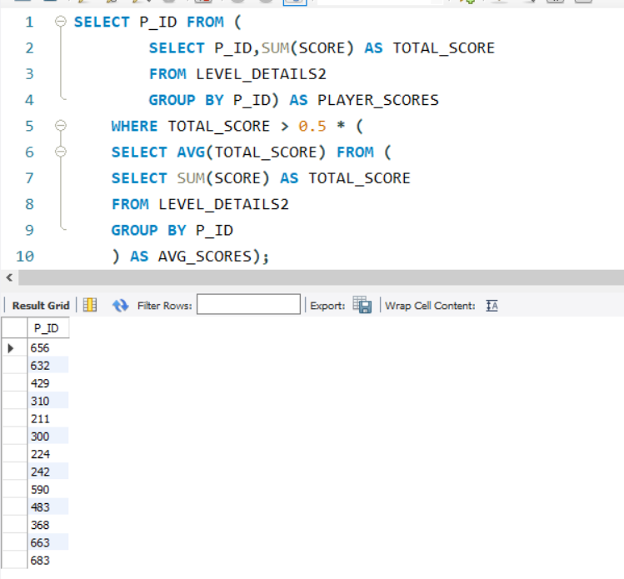
Query – 14
Find players who scored more than 50% of the avg score scored by sum of scores for each player_id.
SELECT P_ID FROM ( SELECT P_ID,SUM(SCORE) AS TOTAL_SCORE FROM LEVEL_DETAILS2 GROUP BY P_ID) AS PLAYER_SCORES WHERE TOTAL_SCORE > 0.5 * ( SELECT AVG(TOTAL_SCORE) FROM ( SELECT SUM(SCORE) AS TOTAL_SCORE FROM LEVEL_DETAILS2 GROUP BY P_ID ) AS AVG_SCORES);
Analysis – It calculates the total score for each player In the inner subquery and then filters the results based on the condition specified.

Slide 21
Query – 15
Create a function to return sum of score for a given player_id
CREATE OR REPLACE FUNCTION GetPlayerScoreSum(player_id INT) RETURNS INT
AS $$ DECLARE
total_score INT;
BEGIN SELECT SUM(score) INTO total_score
FROM Level_Details
WHERE P_ID = player_id;
RETURN total_score;
END;
$$ LANGUAGE plpgsql;
SELECT GetPlayerScoreSum(211) AS total_score;
Analysis – returns the sum of scores for that player from the LEVEL_DETAILS table. The function is defined using PL/pgSQL language. After creating the function, it selects and displays the total score for a specific player ID ( in this case, Player ID 211) using the function.

Slide 22
Summary
The project involved developing a database system for a gaming platform. Here’s the key components and features:
Database Schema : The Project includes a well-structured relational database schema with tables such as ‘Player_Details’ , ‘Level_Details’, and ‘Game_Data’, storing information about players, their game levels, and game statistics.
Data Analysis Queries : various SQL Queries were implemented to perform data analysis task, such as calculating total scores, finding top socres, identifying players with specific characteristics, and computing cumulative statistics.
Stored Procedures and Functions: PL/pgSQL stired procedures and function were utilized to encapsulate complex SQL logic, Improve code modularity and enhance database performance. Functions like ‘GetPlayerScoreSUm’ were created to compute aggregated values based on input parameters.
Windows Function : Windows functions, such as ‘ROW_NUMBER()’ and ‘SUM()’ , ‘OVER()’, were leveraged to perform advanced analytical operatons like ranking scores, calculating cumulative sums, and retrieving data based on specific windows partiions.
Optimized Queries : Effort were made to optimize SQL queries for efficiency and performance, ensuring that data retrieval and precessing task are executed swiftly, even with large datasets.
Overall the project demonstrates proficiency in database design. SQL Porgramming and data analysis techniques. Providing valuable insights into player behavior and game performance metrics.

Slide 23

Thank You

